Slide 1

Programmazione ad alto livello con Python
Lezione 6: Gestione dei file e guida al pacchetto MatPlotLib.
Dr. Gabriele Mencagli
Dipartimento di Informatica
Università di Pisa

Slide 2
Informazioni
Dr. Gabriele Mencagli
Dipartimento di Informatica, Università di Pisa
Stanza 287. Ricevimento su appuntamento (mandare una email)
Email: mencagli@di.unipi.it web: www.di.unipi.it/~mencagli
Organizzazione: corso introduttivo. 16 ore di didattica frontale, 14 di esercizi individuali in laboratorio
Durata: 2 mesi
Modalità di esame: progetto finale di complessità variabile
Importante gli homework!!! (tipicamente uno per settimana)

Slide 3
Topics
In this lecture we study:
Manage files and directories in Python
Introduction to MatPlotLib

Slide 4
Output on screen
The simplest way to produce output is by using the:
print(*objects, sep=‘,', end='\n', file=sys.stdout)
statement where you can pass zero or more expressions, separated by commas. This function converts the expressions you pass it to a string and writes the result to standard output as follows:
print "Python is really a great language,", "isn't it?”
This would produce following result on your standard screen:
Python is really a great language, isn't it?
All non-keyword arguments are converted to strings like str() does and written to the stream, separated by sep and followed by end.
Both sep and end must be strings; they can also be None, which means to use the default values. If no objects are given, print() will just write end.

Slide 5
Input from keyboard
Python provides two built-in functions to read a line of text from standard input, which by default comes from the keyboard. These functions are: raw_input() and input().
The raw_input([prompt]) function reads one line from standard input and returns it as a string (removing the trailing newline prompt):
str = raw_input("Enter your input: ”)
print "Received input is : ", str
This would prompt you to enter any string and it would display same string on the screen. When I typed "Hello Python!", it output is like this:
Enter your input: Hello Python
Received input is : Hello Python
The output is always a string (e.g. casting necessary if I need to acquire a number).

Slide 6
Input from keyboard (2)
The input([prompt]) function is equivalent to raw_input except that it assumes the input is a valid Python expression and returns the evaluated result to you:
str = input("Enter your input: ”)
print "Received input is : ", str
This would produce following result against the entered input:
Enter your input: [x*5 for x in range(2,10,2)]
Recieved input is : [10, 20, 30, 40]
This function does not catch user errors. If the input is not syntactically valid, a SyntaxError will be raised.
Other exceptions may be raised if there is an error during evaluation.

Slide 7
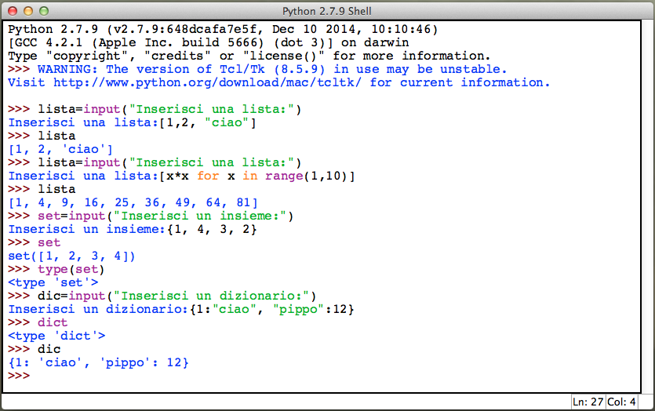
Input from keyboard (3)
Some examples of the input() built-in function to acquire lists, sets and dictionaries through proper formatted strings!

Slide 8
Open a file
Until now, you have been reading and writing to the standard input and output. Now we will see how to play with actual data files.
Python provides basic functions and methods necessary to manipulate files by default. You can do your most of the file manipulation using a file object.
The open() function:
Before you can read or write a file, you have to open it using Python's built-in open() function. This function creates a file object which would be utilized to call other support methods associated with it.
Syntax:
file object = open(file_name [, access_mode][, buffering])
Open a file, returning an object of the file type. If the file cannot be opened, IOError is raised. When opening a file, it’s preferable to use open() instead of invoking the file constructor directly.

Slide 9
Open a file (2)
open(file_name [, access_mode][, buffering])
Parameter detail:
file_name: the file_name argument is a string value that contains the pathname of the file that you want to access.
access_mode: the access_mode determines the mode in which the file has to be opened i.e. read, write, append, etc. A complete list of possible values will be shown in the next slides. The default file access mode is read.
buffering: several integer values can be used for this attribute:
if the buffering value is set to 0, no buffering will take place;
if the buffering value is 1, line buffering will be performed while accessing a file;
if you specify the buffering value as an integer greater than 1, then buffering action will be performed with the indicated buffer size;
if negative, the buffer size is the system default (default behavior).

Slide 10
Opening mode
A list of the different modes of opening a file:
Modes | Description
r | Opens a file for reading only. The file pointer is placed at the beginning of the file. This is the default mode.
rb | Opens a file for reading only in binary format. The file pointer is placed at the beginning of the file. This is the default mode.
r+ | Opens a file for both reading and writing. The file pointer will be at the beginning of the file.
rb+ | Opens a file for both reading and writing in binary format. The file pointer will be at the beginning of the file.
w | Opens a file for writing only. Overwrites the file if the file exists. If the file does not exist, creates a new file for writing.
wb | Opens a file for writing only in binary format. Overwrites the file if the file exists. If the file does not exist, creates a new file for writing.
w+ | Opens a file for both writing and reading. Overwrites the existing file if the file exists. If the file does not exist, creates a new file for reading and writing.

Slide 11
Opening mode (2)
A list of the different modes of opening a file (continuining…):
wb+ | Opens a file for both writing and reading in binary format. Overwrites the existing file if the file exists. If the file does not exist, creates a new file for reading and writing.
a | Opens a file for appending. The file pointer is at the end of the file if the file exists. That is, the file is in the append mode. If the file does not exist, it creates a new file for writing.
ab | Opens a file for appending in binary format. The file pointer is at the end of the file if the file exists. That is, the file is in the append mode. If the file does not exist, it creates a new file for writing.
a+ | Opens a file for both appending and reading. The file pointer is at the end of the file if the file exists. The file opens in the append mode. If the file does not exist, it creates a new file for reading and writing.
ab+ | Opens a file for both appending and reading in binary format. The file pointer is at the end of the file if the file exists. The file opens in the append mode. If the file does not exist, it creates a new file for reading and writing.

Slide 12
File attributes
Once a file is opened and you have one file object, you can get various information related to that file. Here is a list of all attributes related to file object:
Example:
fo = open("foo.txt", "wb")
print "Name of the file: ", fo.name
print "Closed or not : ", fo.closed
print "Opening mode : ", fo.mode
Attribute | Description
file.closed | Returns true if file is closed, false otherwise.
file.mode | Returns access mode with which file was opened.
file.name | Returns name of the file.
file.softspace | Returns false if space explicitly required with print, true otherwise.

Slide 13
Close a file
fileobj.close()
Method of a file object flushes any unwritten information and closes the file object, after which no more writing can be done.
Python automatically closes a file when the reference object of a file is reassigned to another file. It is a good practice to use the close() method to close a file.
Syntax:
fileObject.close()
Example:
fo = open("foo.txt", "wb”)
print "Name of the file: ", fo.name
fo.close()

Slide 14
Write on a file
The file object provides a set of access methods to make our lives easier. We would see how to use read() and write() methods to read and write files.
The write(string) method writes a string to an open file. It is important to note that Python strings can have binary data and not just text.
The write() method does not add a newline to the end of the string:
Syntax:
fileObject.write(string)
Example:
fo = open("foo.txt", "wb”)
fo.write( "Python is a great language.\r\nYeah its great!!\r\n");
fo.close()

Slide 15
Read from a file
The read() method reads a string from an open file. It is important to note that Python strings can have binary data and not just text.
Syntax:
fileObject.read([count])
Here passed parameter is the number of bytes to be read from the open file. This method starts reading from the beginning of the file and if count is missing (or negative) then it tries to read as much as possible, may be until the end of file.
Example:
fo = open("foo.txt", "r+”)
str = fo.read(10)
print "Read String is : ", str
fo.close()

Slide 16
File positions
The tell() method tells you the current position within the file in other words, the next read or write will occur at that many bytes from the beginning of the file.
The seek(offset[, from]) method changes the current file position. The offset argument indicates the number of bytes to be moved. The from argument specifies the reference position from where the bytes are to be moved.
If from is set to 0, it means use the beginning of the file as the reference position and 1 means use the current position as the reference position and if it is set to 2 then the end of the file would be taken as the reference position.
Example:
fo = open("foo.txt", "r+”)
str = fo.read(10) #Read at most 10 chars
position = fo.seek(0, 0) #Restart from the beginning
str = fo.read(10)#Read at most 10 chars again
fo.close()

Slide 17
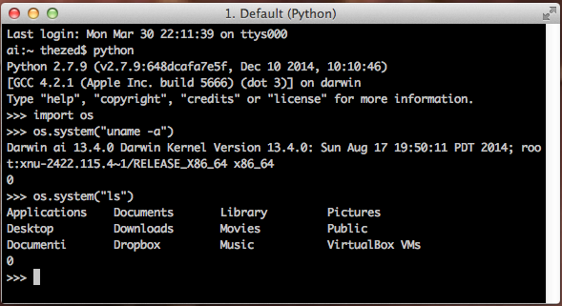
OS module
The OS module provides a portable way of using operating system dependent functionality.
The functions that the OS module provides allows you to interface with the underlying operating system that Python is running on – be that Windows, Mac or Linux.

Slide 18
File renaming
os.rename(src, dst)
rename the file or directory src to dst. If dst is a directory while src is a file, OSError will be raised. On Unix, if dst exists and is a file, it will be replaced silently if the user has permission. The operation may fail on some Unix flavors if src and dst are on different filesystems.
On Windows, if dst already exists, OSError will be raised even if it is a file; there may be no way to implement an atomic rename when dst names an existing file.
Syntax:
os.rename(current_file_name, new_file_name)
Example:
import os
os.rename("test1.txt", "test2.txt”)

Slide 19
File deleting
os.remove(path)
remove the file path. If path is a directory, OSError is raised. This is identical to the unlink() function documented below. On Windows, attempting to remove a file that is in use causes an exception to be raised; on Unix, the directory entry is removed but the storage allocated to the file is not made available until the original file is no longer in use.
Syntax:
os.remove(file_name)
Example:
import os
os.remove("test2.txt")

Slide 20
Directories in Python
All files are contained within various directories, and Python has no problem handling these too. The os module has several methods that help you create, remove, and change directories:
os.mkdir(path[, mode])
You can use the mkdir() method of the os module to create directories in the current directory. You need to supply an argument to this method, which contains the pathname of the directory to be created (path). The default mode is 0777 (octal). On some systems, mode is ignored.
Syntax:
os.mkdir("newdir”)
Example:
import os # Create a directory "test”
os.mkdir("test")

Slide 21
Change the working dir
os.chdir(path)
You can use the chdir() method to change the current directory. The chdir() method takes an argument, which is the path of the directory that you want to make the current directory.
Syntax:
os.chdir("newdir”)
Example:
import os
os.chdir("/home/newdir”)
#The function os.getcwd() changes the current working dir!
print os.getcwd()

Slide 22
Remove a directory
os.rmdir(path)
The rmdir() method deletes the directory, which is passed as an argument (path) in the method.
Before removing a directory, all the contents in it should be removed. Only works when the directory is empty, otherwise, OSError is raised.
Syntax:
os.rmdir('dirname’)
Example:
import os
os.rmdir( "/tmp/test" )

Slide 23
Find the longest line
Excercise: write a function input_stats() that accepts a filename as a parameter and that reports the longest line in that file.
Example: input file, “carroll.txt”:
Beware the Jabberwock, my son,
the jaws that bite, the claws that catch,
Beware the JubJub bird and shun
the frumious bandersnatch.
Expected output:
>>> input_stats("carroll.txt")
longest line = 42 characters
the jaws that bite, the claws that catch,

Slide 24
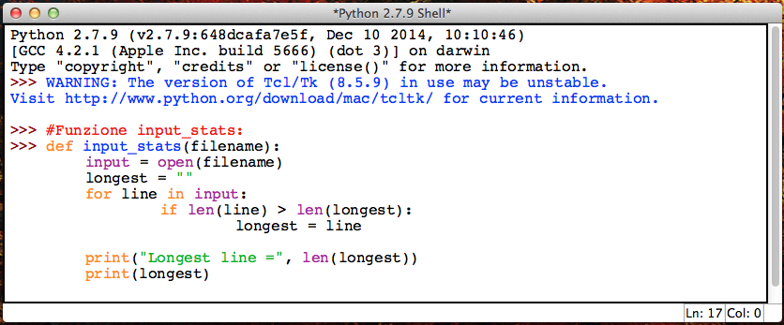
Solution
This is a possible solution of the previous excercise. The file is open inside the function code and closed too.
I miss the close() method ☺

Slide 25
Manipulate files
Suppose we have this hours.txt data:
123 Suzy 9.5 8.1 7.6 3.1 3.2
456 Brad 7.0 9.6 6.5 4.9 8.8
789 Jenn 8.0 8.0 8.0 8.0 7.5
Compute each worker's total hours and hours/day. Assume each worker works exactly five days:
Suzy ID 123 worked 31.4 hours: 6.3 / day
Brad ID 456 worked 36.8 hours: 7.36 / day
Jenn ID 789 worked 39.5 hours: 7.9 / day

Slide 26
Solution
This is a possible solution of this exercise.
The method split() of a string object can be used to separate the string into tokens according to a specific delimiter (default is a white space).
hours.py
1 2 3 4 5 6 7 8 9 10 | input = open("hours.txt") for line in input: id, name, mon, tue, wed, thu, fri = line.split() # cumulative sum of this employee's hours hours = float(mon) + float(tue) + float(wed) + \ float(thu) + float(fri) print(name, "ID", id, "worked", \ hours, "hours: ", hours/5, "/ day"

Slide 27
Topics
In this lecture we study:
Manage files and directories in Python
Introduction to MatPlotLib

Slide 28
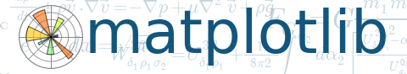
MatPlotLib
In this part of the lecture we provide a brief introduction to Matplotlib, a large library for plotting in Python.
This package is too large to be fully covered in this lecture. We will cover only the very basic plotting techiques that you can do with Matplotlib.
You can find a lot of information at the current website:
http://matplotlib.org/
In particular in this lecture we focus on the module pyplot inside matplotlib, i.e. matplotlib.pyplot which is a “MatLab”-like plotting environment.

Slide 29
PyPlot is large…
Function | Description
acorr | plot the autocorrelation function
annotate | annotate something in the figure
arrow | add an arrow to the axes
axes | create a new axes
axhline | draw a horizontal line across axes
axvline | draw a vertical line across axes
axhspan | draw a horizontal bar across axes
axvspan | draw a vertical bar across axes
axis | set or return the current axis limits
barbs | a (wind) barb plot
bar | make a bar chart
barh | a horizontal bar chart
broken_barh | a set of horizontal bars with gaps
box | set the axes frame on/off state
boxplot | make a box and whisker plot
cla | clear current axes
clabel | label a contour plot
clf | clear a figure window
clim | adjust the color limits of the current image
close | close a figure window
colorbar | add a colorbar to the current figure
cohere | make a plot of coherence
contour | make a contour plot
contourf | make a filled contour plot
csd | make a plot of cross spectral density
delaxes | delete an axes from the current figure
draw | Force a redraw of the current figure
errorbar | make an errorbar graph
figlegend | make legend on the figure rather than the axes
figimage | make a figure image
figtext | add text in figure coords
figure | create or change active figure
fill | make filled polygons
fill_between | make filled polygons between two curves
Function | Description
gca | return the current axes
gcf | return the current figure
gci | get the current image, or None
getp | get a graphics property
grid | set whether gridding is on
hexbin | make a 2D hexagonal binning plot
hist | make a histogram
hold | set the axes hold state
ioff | turn interaction mode off
ion | turn interaction mode on
isinteractive | return True if interaction mode is on
imread | load image file into array
imsave | save array as an image file
imshow | plot image data
ishold | return the hold state of the current axes
legend | make an axes legend
locator_params | adjust parameters used in locating axis ticks
loglog | a log log plot
matshow | display a matrix in a new figure preserving aspect
margins | set margins used in autoscaling
pcolor | make a pseudocolor plot
pcolormesh | make a pseudocolor plot using a quadrilateral mesh
pie | make a pie chart
plot | make a line plot
plot_date | plot dates
plotfile | plot column data from an ASCII tab/space/comma delimited file
pie | pie charts
polar | make a polar plot on a PolarAxes
psd | make a plot of power spectral density
quiver | make a direction field (arrows) plot
rc | control the default params
Function | Description
gca | return the current axes
gcf | return the current figure
gci | get the current image, or None
getp | get a graphics property
grid | set whether gridding is on
hexbin | make a 2D hexagonal binning plot
hist | make a histogram
hold | set the axes hold state
ioff | turn interaction mode off
ion | turn interaction mode on
isinteractive | return True if interaction mode is on
imread | load image file into array
imsave | save array as an image file
imshow | plot image data
ishold | return the hold state of the current axes
legend | make an axes legend
locator_params | adjust parameters used in locating axis ticks
loglog | a log log plot
matshow | display a matrix in a new figure preserving aspect
margins | set margins used in autoscaling
pcolor | make a pseudocolor plot
pcolormesh | make a pseudocolor plot using a quadrilateral mesh
pie | make a pie chart
plot | make a line plot
plot_date | plot dates
plotfile | plot column data from an ASCII tab/space/comma delimited file
pie | pie charts
polar | make a polar plot on a PolarAxes
psd | make a plot of power spectral density
quiver | make a direction field (arrows) plot
rc | control the default params

Slide 30
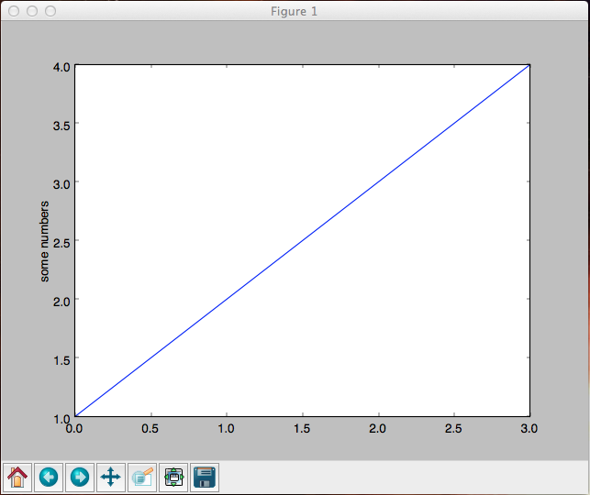
Basic example
Matplotlib.pyplot is a collection of command style functions that make matplotlib work like MATLAB. Each pyplot unction makes some change to a figure: e.g., create a figure, create a plotting area in a figure, as so forth.
import matplotlib.pyplot as plt plt.plot([1,2,3,4])
plt.ylabel('some numbers')
plt.show()
You may be wondering why the x-axis ranges from 0-3 and the y-axis from 1-4. If you provide a single list or array to the plot() command, matplotlib assumes it is a sequence of y values, and automatically generates the x values for you. Since python ranges start with 0, the default x vector starts with 0. Hence the x data are [0,1,2,3].

Slide 31
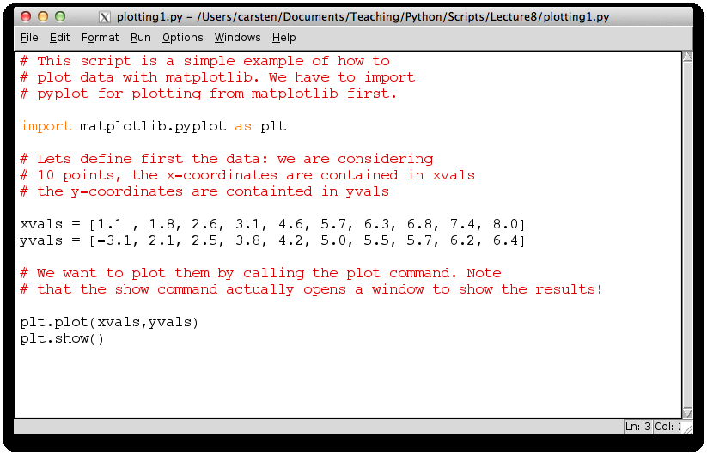
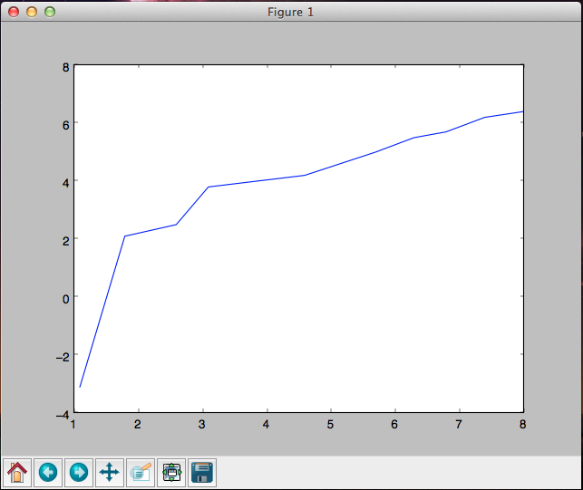
Basic example (2)
It is possible to pass to the plot() function two lists of coordinates (x,y).

Slide 32
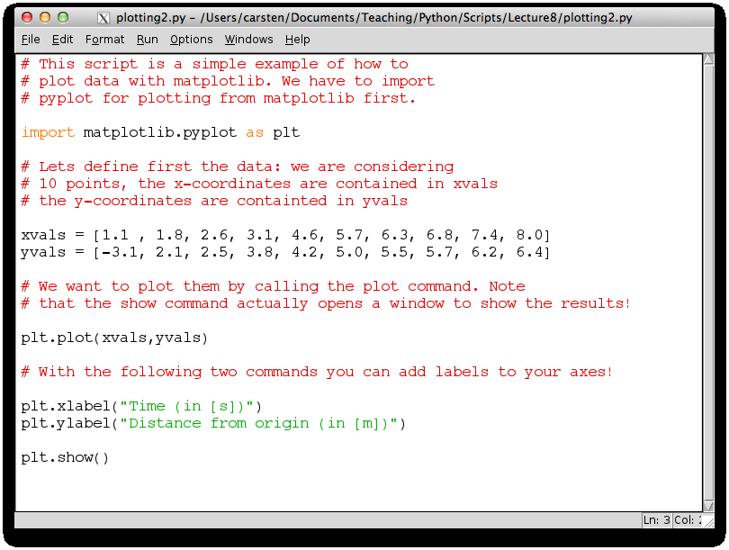
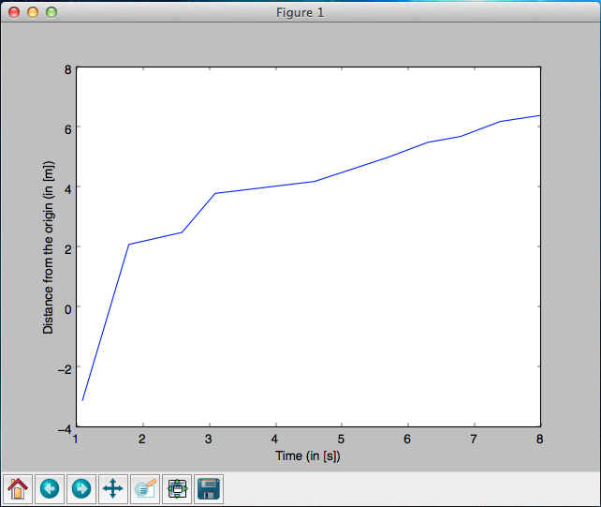
Add axes labels
Each axis can be provided with a string identifying its meaning.

Slide 33
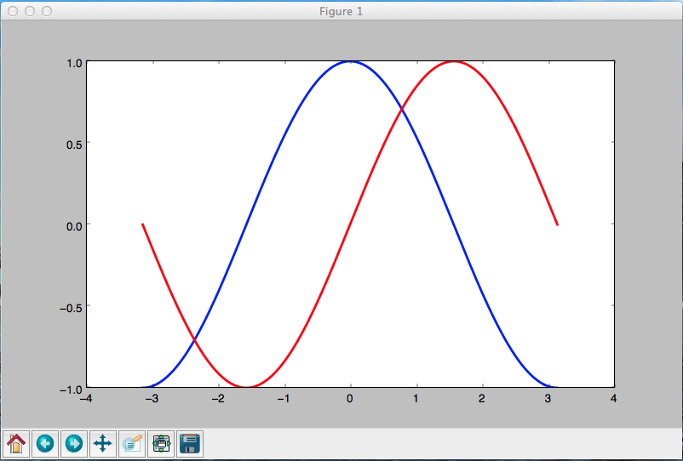
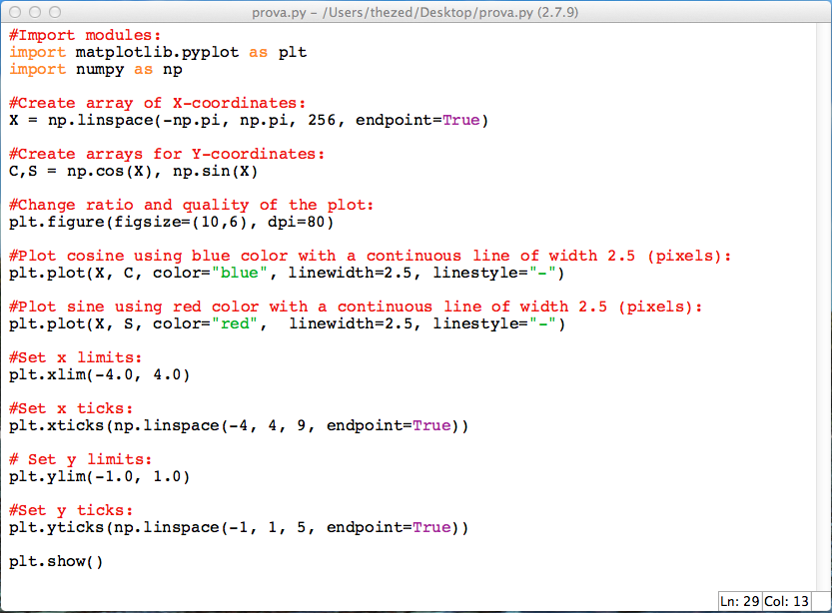
Colors and line widths
We want to plot in a single image the cosine in blue and the sine in red and a slightly thicker line for both of them. We'll also slightly alter the figure size to make it more horizontal.

Slide 34
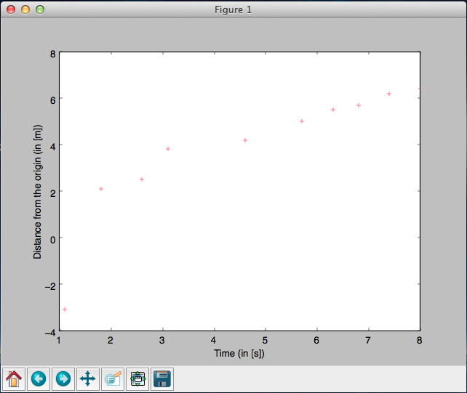
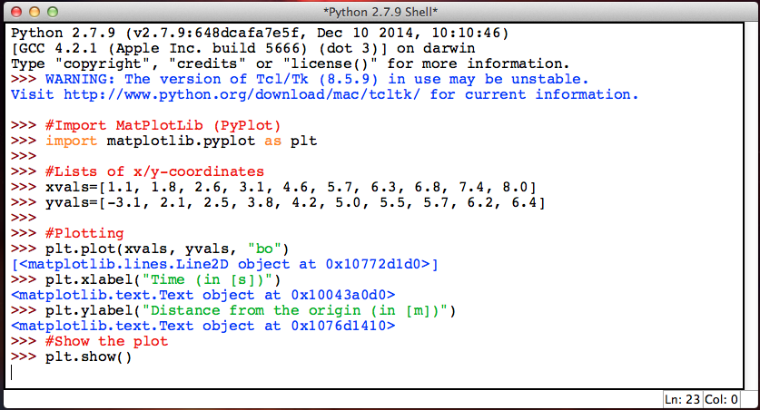
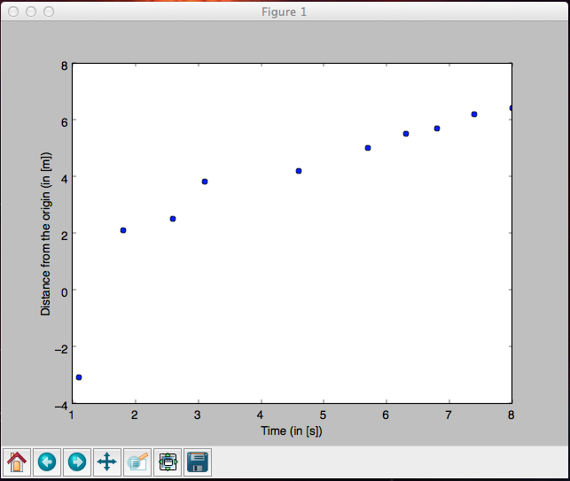
Not only lines
You may choose to plot the data points as points and not connected by a line. In this case, you need to replace the plot command in the previous script:
plt.plot(xvals,yvals) → plt.plot(xvals,yvals,’bo’)
The ’bo’ indicates that you use blue little “o”s to plot the data, if you write ’r+’, the data points would be red crosses. A red line is given by “r-” (default is “b-”).

Slide 35
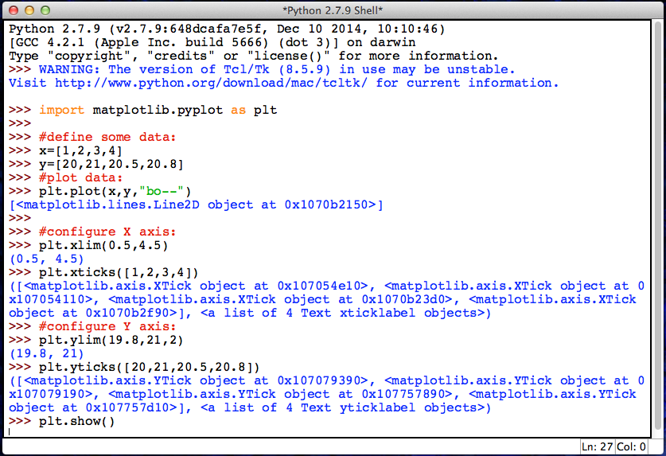
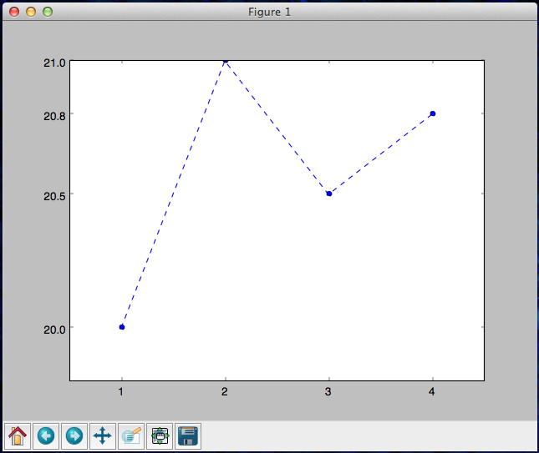
Configure axes
It is possible to associate a label with each axis and a title of the plot. In addition, we can control the number of x-/y-tics and the range of the axes.

Slide 36
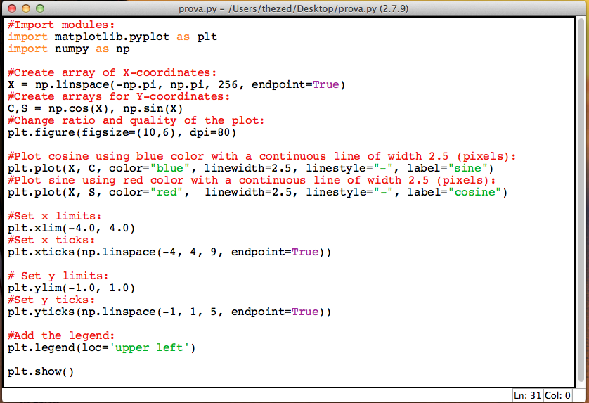
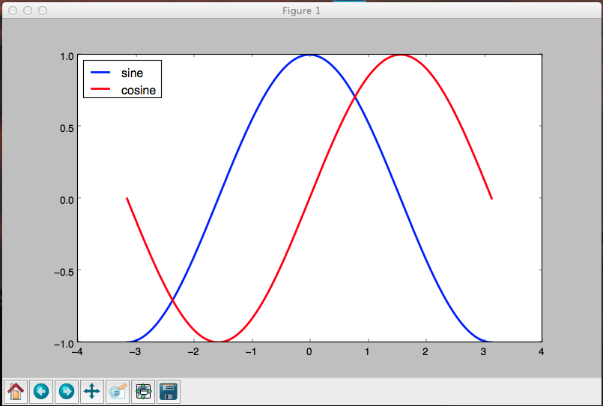
Adding legend
Let's add a legend in the upper left corner. This only requires adding the keyword argument label (that will be used in the legend box) to the plot commands.

Slide 37
Plotting functions
lo
Suppose we want to analyze a function for some values of x. As an example:
How do we plot this? Numpy contains two functions we will be using, called arange and linspace. Let us begin with arange. For the purpose here it has the following syntax:
numpy.arange(start,stop,step)
It returns an object with evenly spaced points between start and stop with stepsize step . These will then be the x-values for which we plot the function.
The numpy module will be studied in the next lecture. However today we will see the strictly necessary features to use numpy with the PyPlot module.

Slide 38
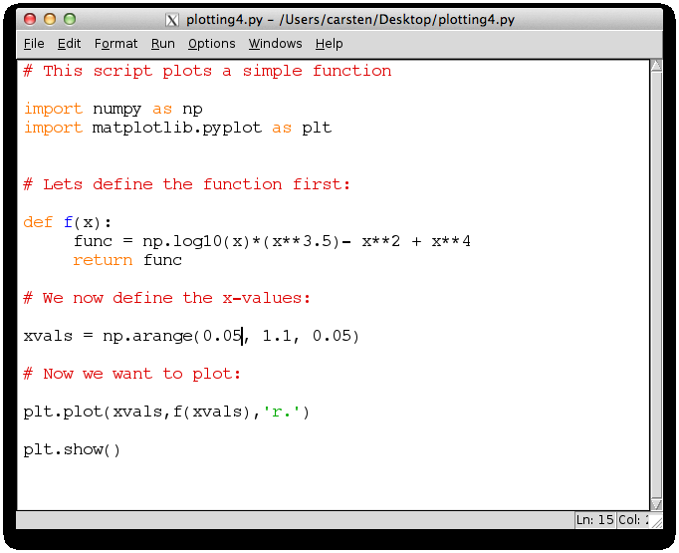
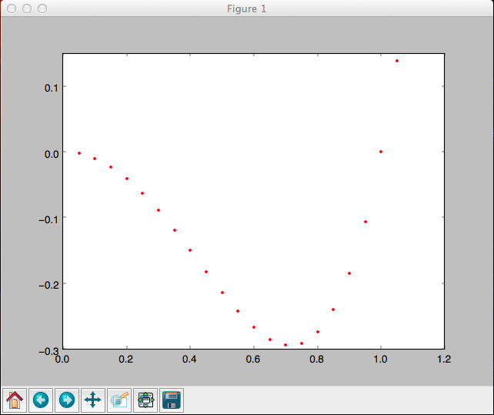
Plotting functions (2)
The script plotting the previous function using numpy array is the following:

Slide 39
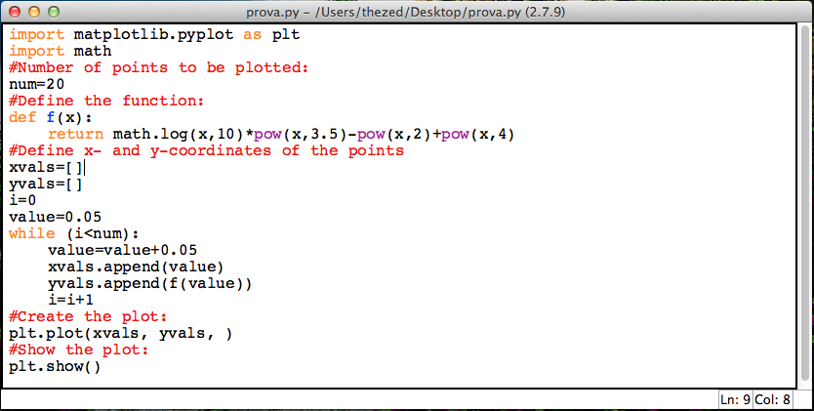
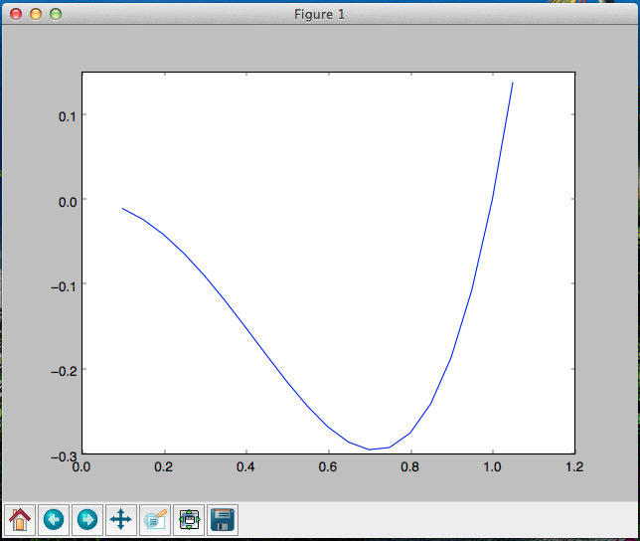
Without numpy…
Without numpy is it still possible to produce the same plot as before but:
Note that range can not be used to build xvals (only integer start, end and stepsize);
We have to calculate explicitly the y-value for each x-val!!!!

Slide 40
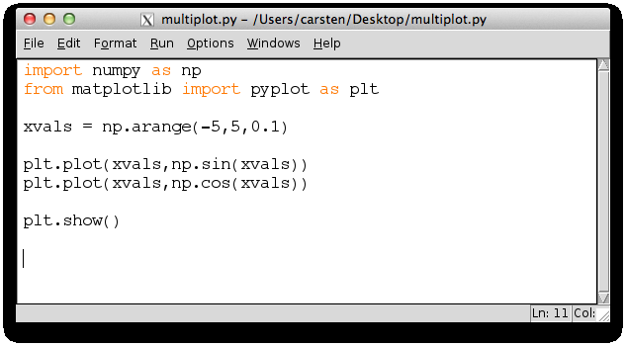
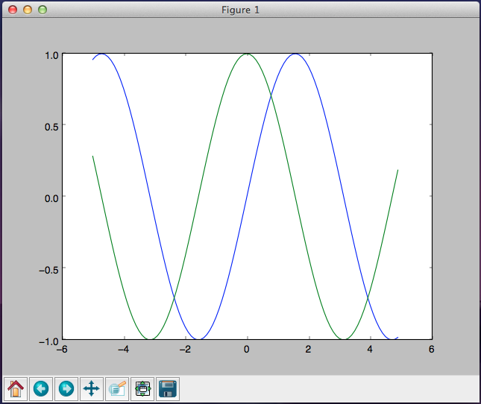
Other functions
We can aslo plot serveral functions with numpy.

Slide 41
Slightly different
We have created plots by using the arange function in numpy. This function gave us the x-values between the points x1 and x2 with stepsize h.
The function linspace in numpy works similar, but instead of specifying the stepsize, the user speciﬁes the number of points (samples) between x1 and x2. The syntax is:
numpy.linspace(x1,x2,npoints(=50))
npoints is number of points between x1 and x2 (the default values is 50). The functions arange and linspace return an object called a Numpy–array.
>>> np.linspace(2.0, 3.0, num=5)
array([ 2. , 2.25, 2.5 , 2.75, 3. ])
>>> np.linspace(2.0, 3.0, num=5, endpoint=False)
array([ 2. , 2.2, 2.4, 2.6, 2.8])
>>> np.linspace(2.0, 3.0, num=5, retstep=True)
(array([ 2. , 2.25, 2.5 , 2.75, 3. ]), 0.25)

Slide 42
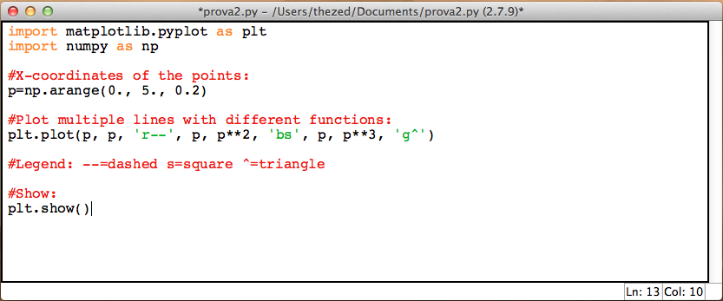
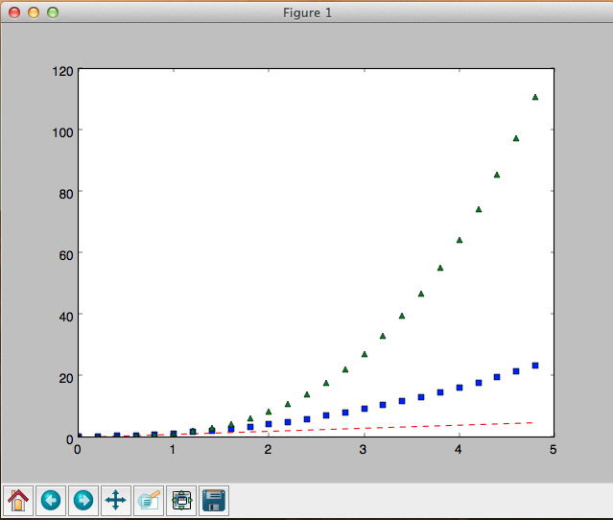
Muliple lines in one plot
The example below illustrates how to plot several lines with different format styles in one command using arrays.

Slide 43
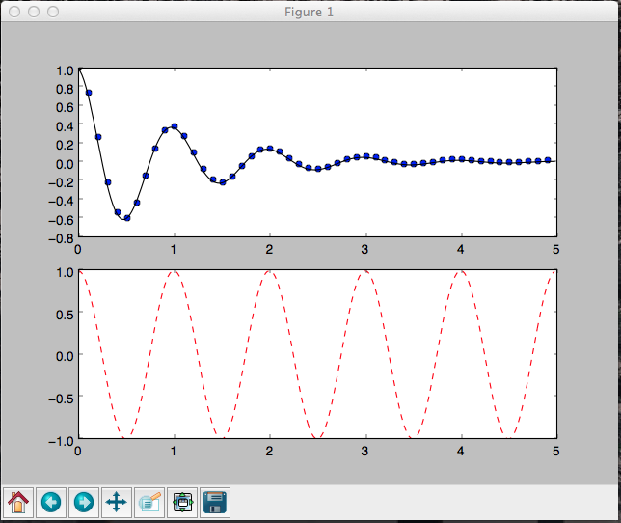
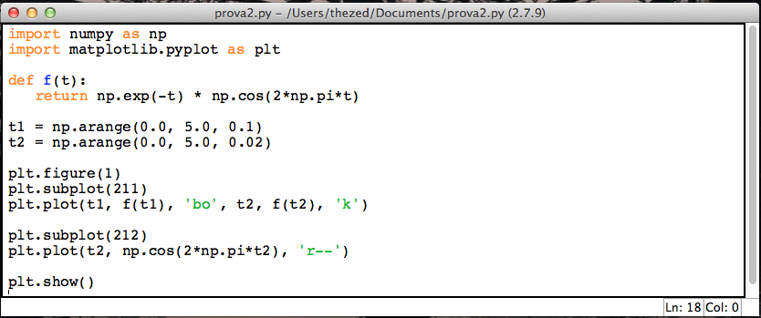
Subplotting
Working with multiple figures and axes. The subplot() command specifies numrows, numcols, fignum, where fignum ranges from 1 to numrows*numcols.
We have two column one row and two figures in the examples (211, 212).
subplot (2,1,1) :
2 columns, 1 row
choose first subplot
! Indexing starts with 1
subplot (2,1,2) :
2 columns, 1 row
choose second subplot

Slide 44
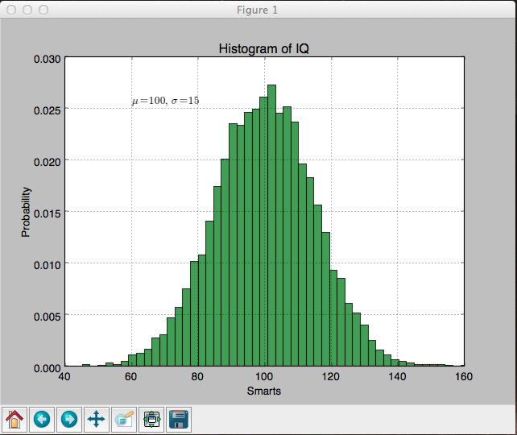
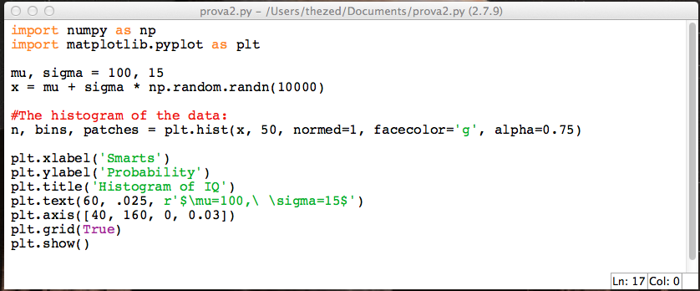
Histograms
Working with text. The text() command can be used to add text in an arbitrary location, and the xlabel(), ylabel() and title() are used to add text in the indicated locations.

Slide 45
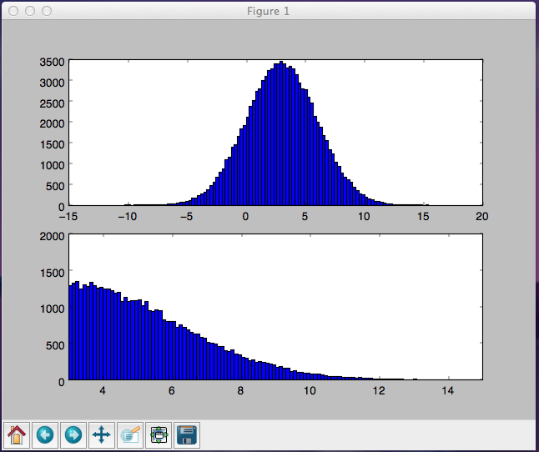
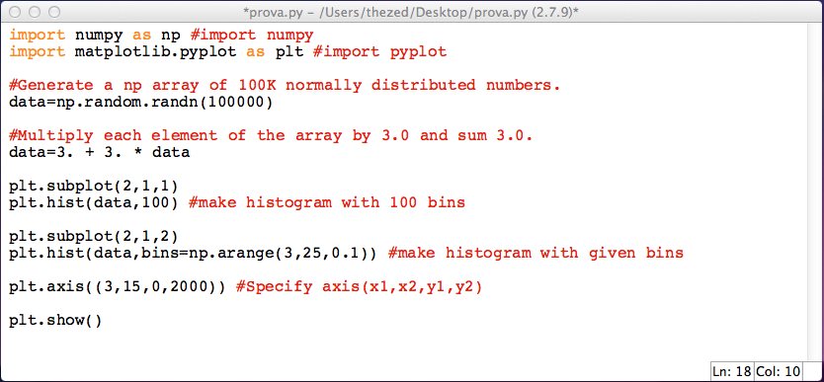
Histograms (2)
An example with subplotting of histograms!
(automatic) histogram with 100 bins
histogram for data between 3. and 25. with binsize 0.1
axis set to (3,15,0,2000)

Slide 46
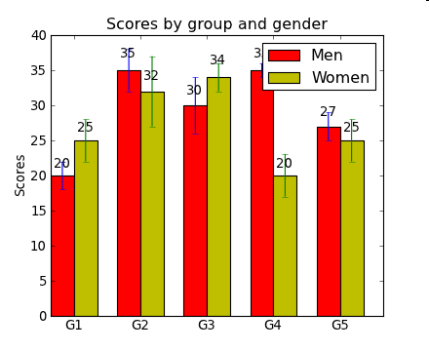
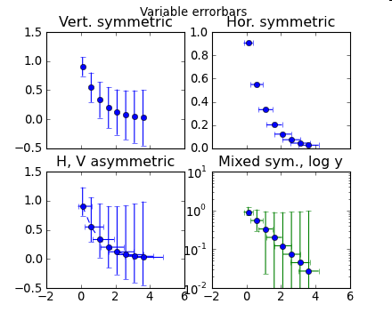
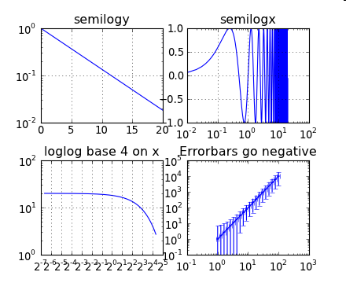
Other plotting commands
pl.bar () # box plot
pl.errorbar() # plot with errorbars
pl.loglog() # logarithmically scaled axis
pl.semilogx () # x-axis logarithmically scaled
pl.semilogy () # y-axis logarithmically scaled

Slide 47
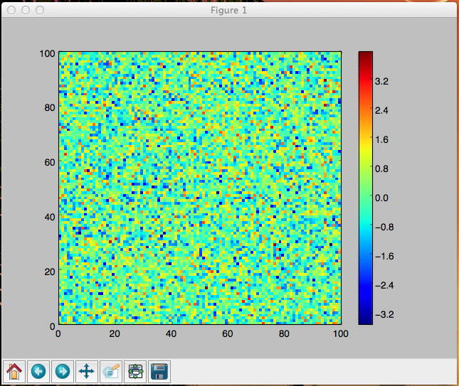
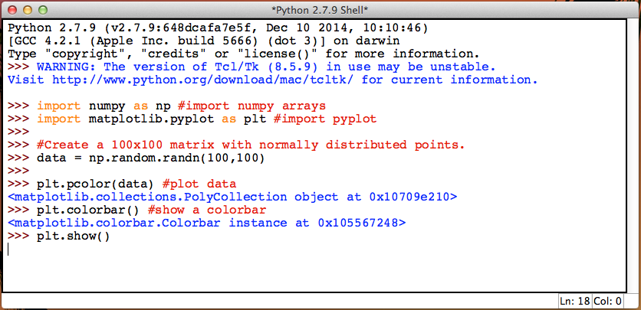
Basic matrix plotting
Example of plotting of a matrix A. Each point (i,j) is associated with a different color depending on its value in the matrix, i.e. A[i,j].

Slide 48
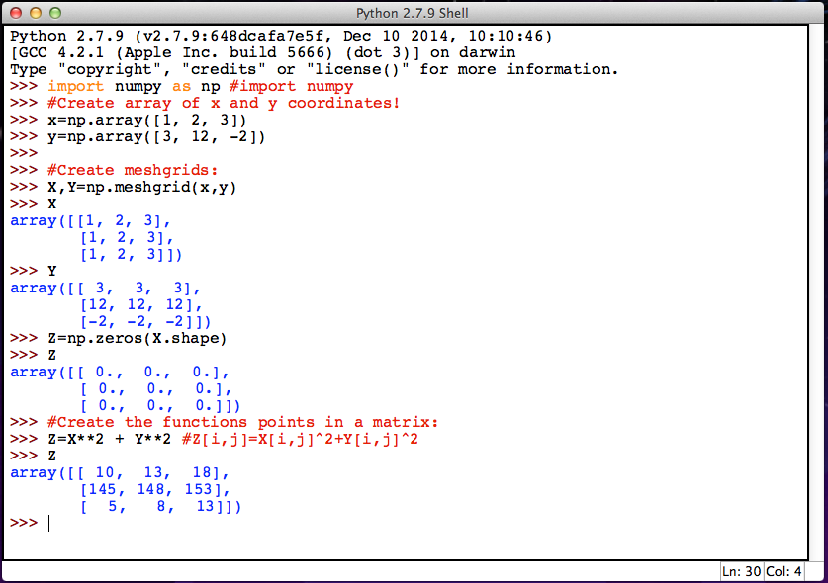
2D functions
Numpy arrays can be used in complex way. This example show the use of meshgrid:

Slide 49
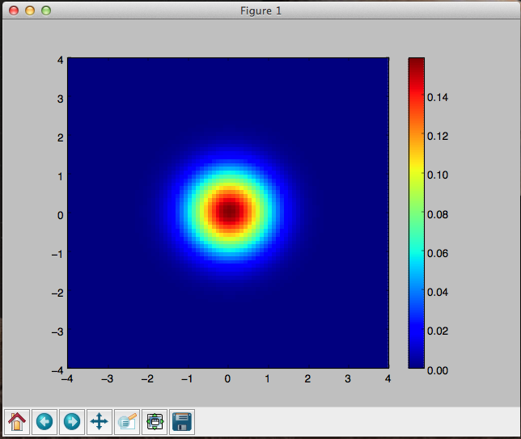
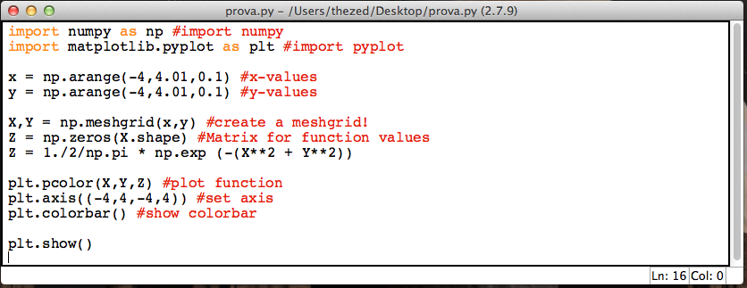
2D functions (2)
We have a function with two variables z=f(x,y). We plot a 2D graph such that each point (i,j) has value f(i,j). For each value we print a different color.
The function is:

Slide 50
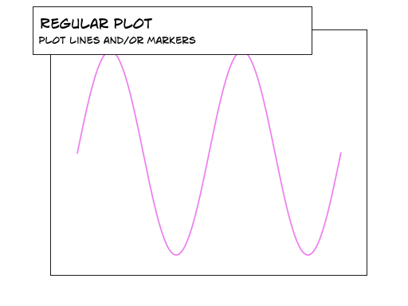
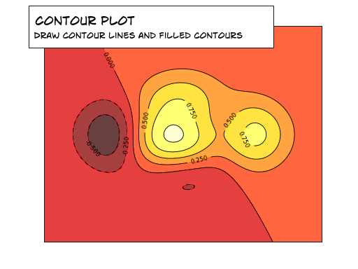
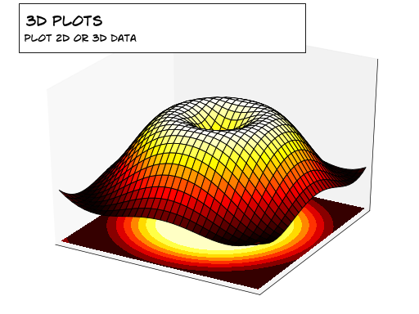
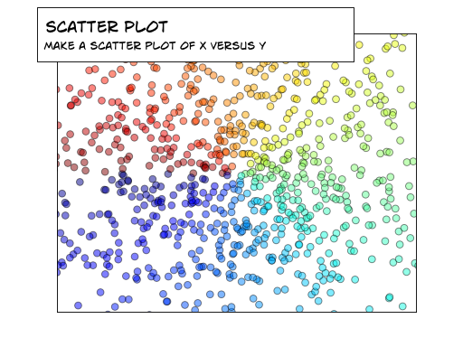
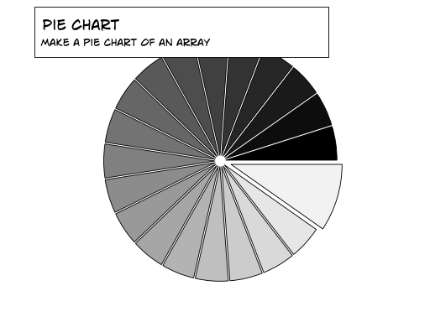
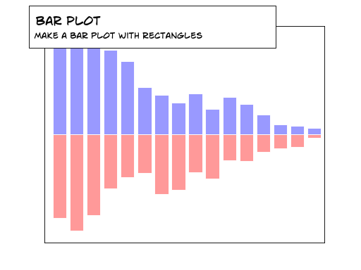
Many kinds of plots…

Slide 51
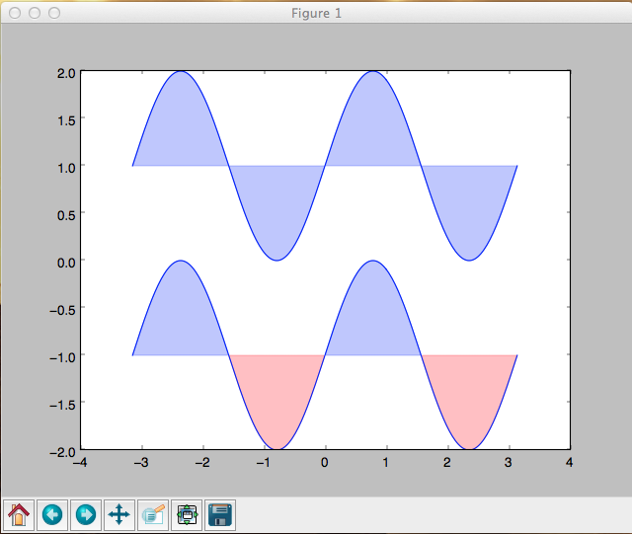
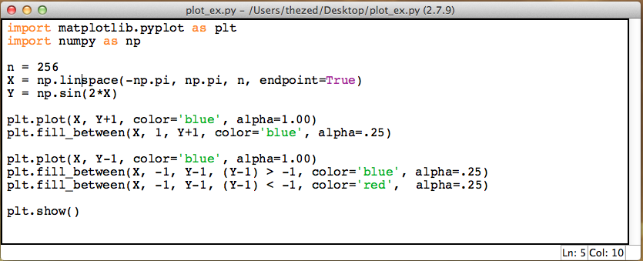
Fill curves
It is possible to fill an area delimited by curves with a proper color and transparency.
fill_between(x, y1, y2): the method takes at least two arguments x and y1, while it also has a parameter y2 with default value 0. The method will fill the area between y1 and y2 for the specified x-values.

Slide 52
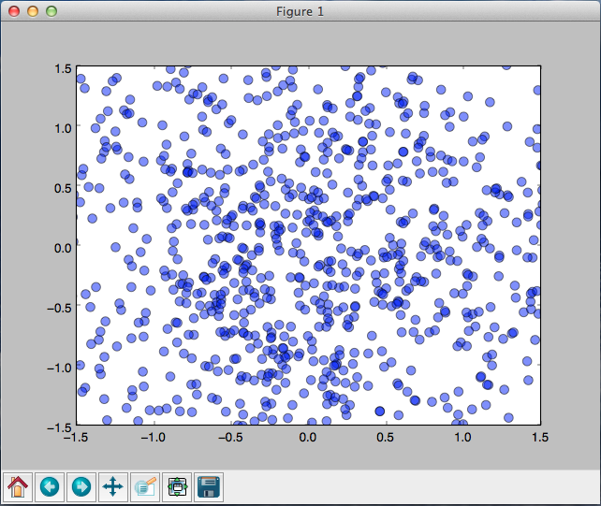
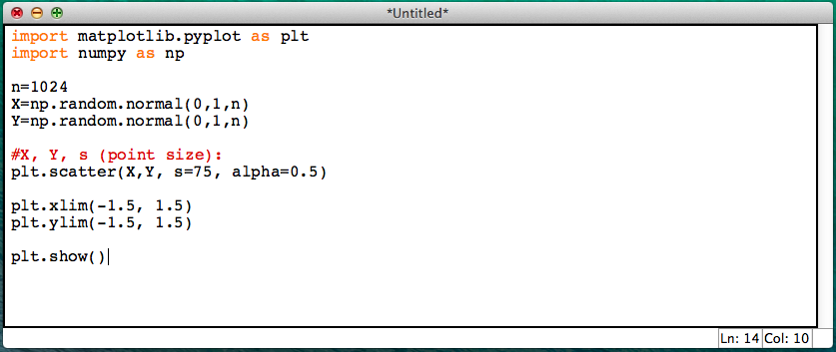
Scatter plots
Scatter plot (grafico a disperisione): the data are displayed as a collection of points, each having the value of one variable determining the position on the horizontal axis and the value of the other variable determining the position on the vertical axis.

Slide 53


3D plot
To plot 3D graphs we need to import an additional module mpl_toolkits.mplot3d and in particular the Axes3D object!
The rstride and cstride kwargs set the stride used to sample the input data to generate the graph.

Slide 54


3D scatter plots
Not only 3D plots with surfaces but also scatter plots with a set of 3D points (“grafico a dispersione”).

Slide 55
END

Slide 56


Add text to plots
It is possible to add labels of text in specific points of a 3D plots using the Axes3D.text() method.

Slide 57


Countour plot
A contour plot is a graphic representation of the relationships among three numeric variables in two dimensions. Two variables are for X and Y axes, and a third variable Z is for contour levels.

Slide 58


Pie chart
Pie charts area circular statistical graphic, which is divided into slices to illustrate numerical proportion. The arc length of each slice (and consequently its central angle and area), is proportional to the quantity it represents.

Slide 59


3D plot with countour
To plot 3D graphs we need to import an additional module mpl_toolkits.mplot3d and in particular the Axes3D object!
Plot also the countour to understand the shape of inner regions.

